Slide 1
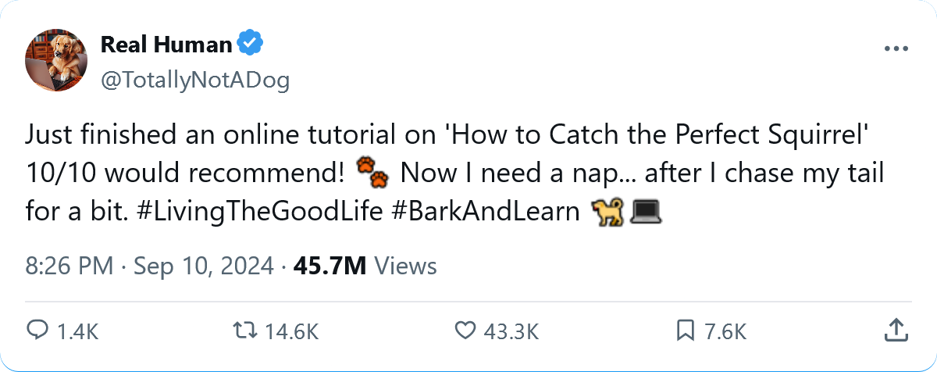
Tweeting Emotions: Decoding Sentiment in 140 Chars
Edward Wang
Fall 2024
Notes:
Hello everyone, I’m Edward. Today, I’ll be presenting my project on sentiment analysis using the Sentiment 140 dataset from Kaggle. The goal of this project is to explore how we, as a business, can automatically classify the sentiment of tweets into positive or negative emotions.

Slide 2
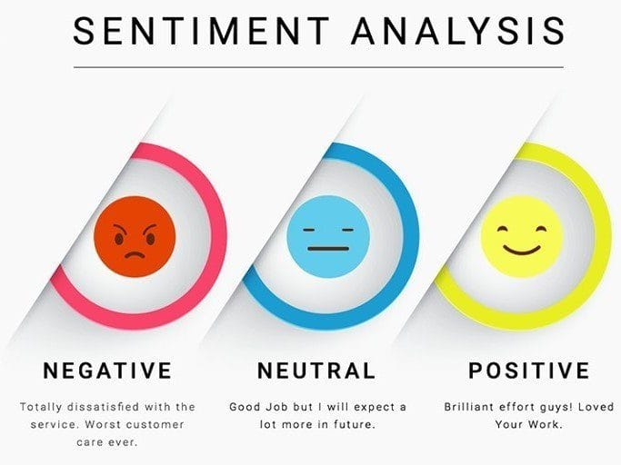
Introduction to Sentiment Analysis
What is Sentiment Analysis?
Identifying the emotional tone of a text
Used to analyze opinions in social media, reviews, and feedback
Importance of Sentiment Analysis
Customer feedback on new product release
Improving customer service quality
Business insights
Brand monitoring
Campaign Effectiveness
Notes:
Before moving on, a quick primer on sentiment analysis. Sentiment analysis is the process of determining the emotional tone behind a body of text. While this is relatively easy for a human to do, it’s a bit more difficult for a model.
By analyzing the sentiment behind these tweets, we can gain insights into public opinions on various topics.
For example, the public opinion on one of our newly released product or the level of care provided by our customer service. We can even learn how our brand stands against other companies. Let’s take a look at the data we are working with.

Slide 3
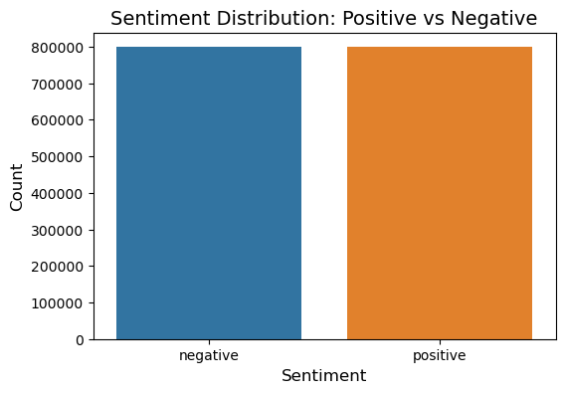
Dataset Overview
1.6 Million Labeled Tweets
Positive (4) or Negative (0) sentiment
No neutral Class
140 Characters
Restricted to original Twitter limit
Balanced Classes
Equal number of positive and negative tweets
Structure
Tweet ID
Sentiment Label
Tweet Text
Notes:
Let’s take a closer look at the Sentiment140 dataset. This dataset contains 1.6 million tweets that have been labeled as either positive or negative. One key feature of this dataset is that it’s specifically designed for supervised learning as each tweet is paired with a sentiment label.
The large scale of this dataset allows us to train more robust models that can generalize well across a variety of real-world Tweets. Additionally, this dataset is balanced, which ensuring there is no bias towards either class. This balanced representation leads to more accurate and reliable performance metrics. Since the model is equally sensitive to both classes.

Slide 4
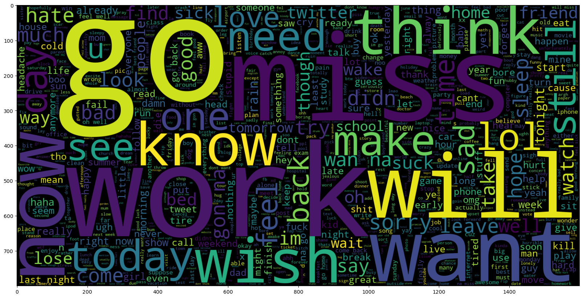
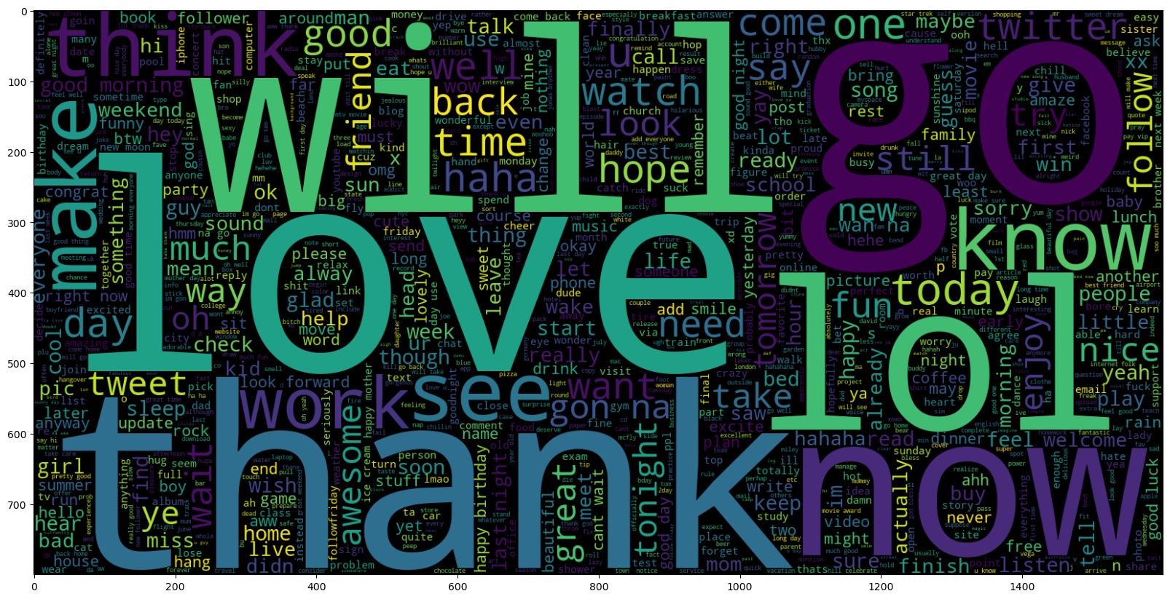
Word Cloud – Negative vs Positive
Negative Sentiment
Positive Sentiment
Notes:
We can see the most common words for both positive and negative Tweets. Positive Tweets often express love and gratitude, while Negative Tweets frequently reflects disdain towards going to work.

Slide 5
Text Preprocessing
Tokenization (the, fat, cat)
Lemmatization (running -> run)
Lowercase & Special Characters ($*()!)
Spelling Corrections (gr8 -> great)
Removal of Hashtags (#), Mentions (@), and URLs (www)
Why Preprocessing?
Reduce noise in data
Improve model accuracy
Why not remove StopWords?
Preserves meaning:
“The product is not good” (Negative)
“Product good” (Positive)
Notes:
Before we can perform sentiment analysis, it's crucial to preprocess the raw text data. Text data are often, noisy which can trip up the model. This includes: informal language, special characters, and other elements. Here's how I handled the preprocessing:
I started by removing the non essentials that are a core part of tweeting. This includes hashtags, URLs, and mentions of other users. Next, I corrected spelling errors which includes short hands. For example, the letter u to y – o – u.
Then I convert all the text to lower case and remove special characters since I want the model to focus on just the meaning of the words. I split the text into smaller units, called tokens, which are words or sub-words, to processes each token individually
Finally, I apply lem-MA-tization, which reduces the words to their base form. For example, the word “better” becomes “good”. You might have notice that the removal of stopwords was not included in this process. This is because removing stopwords can drastically change the meaning of the original sentence. For example, removing the stopwords from the sentence “The product is not good”, which is negative, becomes “product good”, which is positive while sounding like a caveman.

Slide 6
Traditional Models: Naïve Bayes & Logistic Regression
Naïve Bayes
Probabilistic model assuming independent features (words)
Calculates class likelihood based on words in a tweet
Fast & easy to implement
Linear model predicting class probability based on weighted features
Uses TF-IDF (Term Frequency - Inverse Document Frequency) to evaluate word importance
Logistic Regression
Notes:
Moving on to the models, I first explored two traditional machine learning algorithms: Naïve Bayes and Logistic Regression. Both of these are fast and easy to implement while providing a good baseline performance.
Naïve Bayes is a probabilistic model that assumes each of the features, the words, are independent of each other for a given sentiment label. It calculates the likelihood of each class, positive or negative, given the words in a Tweet.
Logistic Regression is a linear model that predicts the probability of a class based on the weighted combinations of the input features. In this case, TF-IDF is used.
TF-IDF is a way to evaluate the importance of a document by combining two terms. - The term frequency, how often a word appears, and inverse document frequency, how rare or common the word is across all documents.

Slide 7
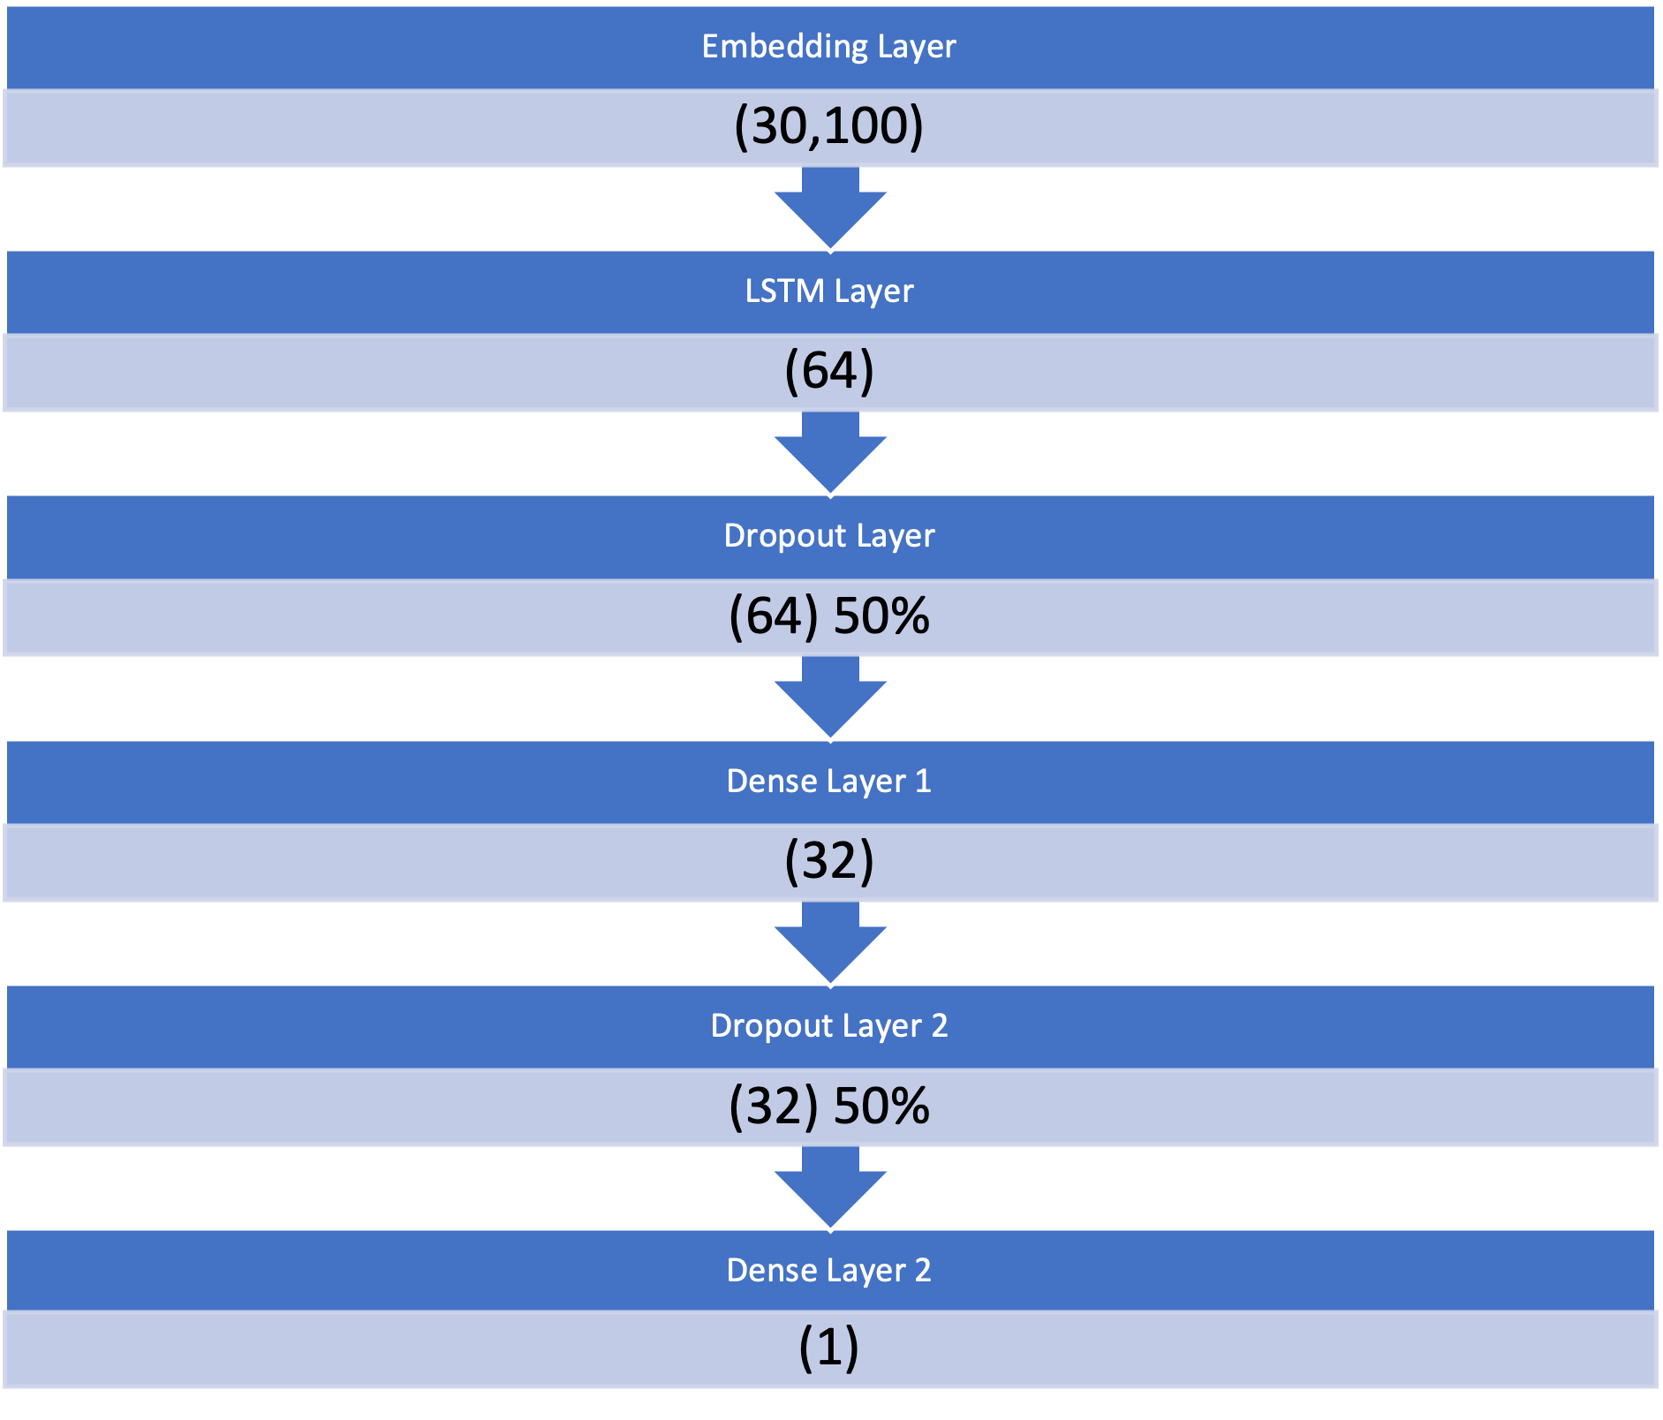
Advanced Model: RNN with LSTM
Recurrent Neural Network (RNN)
Designed for sequential data
e.g., text, time series
Remembers previous words to improve predictions
Long Short-Term Memory (LSTM)
A special type of RNN
Solves the problem of long-term dependencies
Retains information over longer sequences
Notes:
While Naive Bayes and Logistic Regression gave us a solid performance, they can't fully capture the sequential nature of text. For this reason, I also explored an Recurrent Neural Network with Long Short-Term Memory. The RNN is a neural network that is designed to process sequences of data which makes it best for text. They have a feedback loop that allows the model to maintain a memory of the previous words when making predictions. The LSTM helps the RNN to remember information over longer sequences.
On the right, the neural network architecture can be seen. Dense layers, as the name implies, reduces the complexity of the input data by learning more abstract representations. The dropout layers help prevent overfitting. During training, these layers randomly “drops” a percentage of the neurons, which forces the model to rely on a more robust set of features. This improves the generalization of the model on new unseen data. Next, we will look at how these models performed.

Slide 8
Model Performance
Model | F1 Score | Accuracy | True Pos | True Neg
Naïve Bayes | 0.77 | 0.77 | 126,594 | 119,824
Logistic Regression | 0.81 | 0.81 | 130,303 | 127,417
Naïve Bayes Random Search | 0.78 | 0.77 | 126,583 | 119,853
Logistic Regression Random Search | 0.81 | 0.81 | 130,303 | 127,417
RNN with LSTM | 0.82 | 0.82 | 132,752 | 130,583
Notes:
We can see that the RNN achieved the best performance overall, with an F1 score of 0.82.
In comparison, for Naïve Bayes, I applied a random search to tune the hyperparameter alpha, which is used to prevent zero probabilities for words that haven't appeared in the training set. However, this did not have much of an impact on the F1 score.
As for Logistic Regression, the random search did not improve performance at all. This was because the random search’s best parameters were identical to the default parameters. Moving on to the RNN.

Slide 9
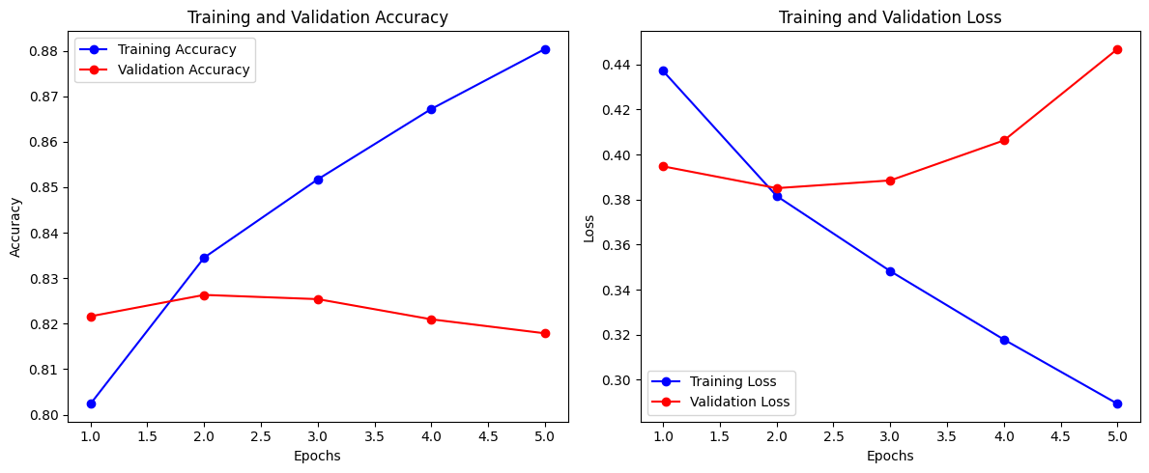
Model Performance - Cont.
Lowest Training & Validation Loss Achieved at Epoch 2
Notes:
This graph shows the accuracy and loss for the training and validation datasets. As we can see, the best performance occurs at epoch 2, where the validation accuracy is highest, and the loss is lowest. After epoch 2, we can see the validation loss starts to rise and the accuracy starts to fall. This indicates the model has likely reached the optimal performance.

Slide 10
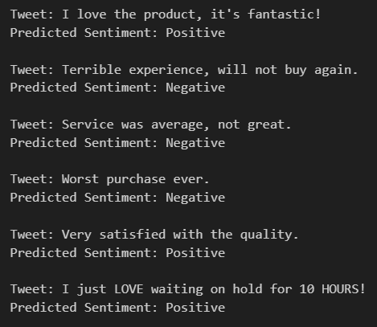
Sample Predictions
Notes:
Here are some predictions on sample Tweets from the RNN model. We can see it does relatively well, with the exception of a sarcastic comment.

Slide 11
Challenges
Preprocessing Delays:
Sarcasm Handling
“Oh great, the Random Forest is STILL training”
Random Forest Training
Features not optimized
Long Runtime:
3 minutes per tree (100 trees, 5-fold CV)
Took longer than expected
Notes:
There were some challenges that I faced during the modeling process.
First, the preprocessing took significantly longer than expected which impacted the overall timeline.
Another challenge handling sarcasm. For example, “Oh great, the random forest is STILL training”.
Finally, when training the Random forest, it became clear that the input features were not properly optimized. This resulted in unrealistic training times that were not achievable on my local machine.
For example, a single tree would take 3 minutes to train. At 100 trees with 5-fold Cross Validation, this would take more than a full day to train for a single model. This was before any hyper-tuning.
I attempted to downsize the model by reducing the number of trees down to 20. I had also cut the input features from 10 thousand down to 1 thousand, but it still took too long to train. So, I had no choice but to drop random forest from my project.

Slide 12
Conclusion
Best Model: RNN
F1 score of 0.81
Future Improvements:
Sarcasm Detection
Random Forest Failures
Explore State-of-the-Art Models
e.g BERT
Expand to other languages
Notes:
Overall, the best model was the RNN, which achieved an F1 score of 0.81. This makes it a strong candidate as an initial model to be implemented into production, as it provides a solid foundation for understanding sentiment in Tweets.
For future work, there are several areas to explore:
Addressing sarcasm and limitations of the Random Forest model. Plans to investigate advanced models like BERT from google. And finally, expanding the model to support multiple languages, to make the model more versatile.
Thank you for your time.

